Slide 1
WHAT'S THE MOVE
Launch & Marketing Plan
The ultimate real-time college nightlife compass.
Auto-detect house parties • Discover local bars • Stay safe & vibe right.
Prepared by Kutter Thornton | May 2026

Slide 2




The Problem
College students are flying blind every weekend.
Scattered Info
GroupMe spam, Instagram stories, word-of-mouth. No central reliable source.
Missed Opportunities
Best house parties and bar specials go undiscovered until it's too late.
Safety Risks
Unverified events, unknown crowds, no real-time safety signals or friend tracking.
Decision Fatigue
Hours wasted texting friends 'where's the move?' instead of actually going out.

Slide 3

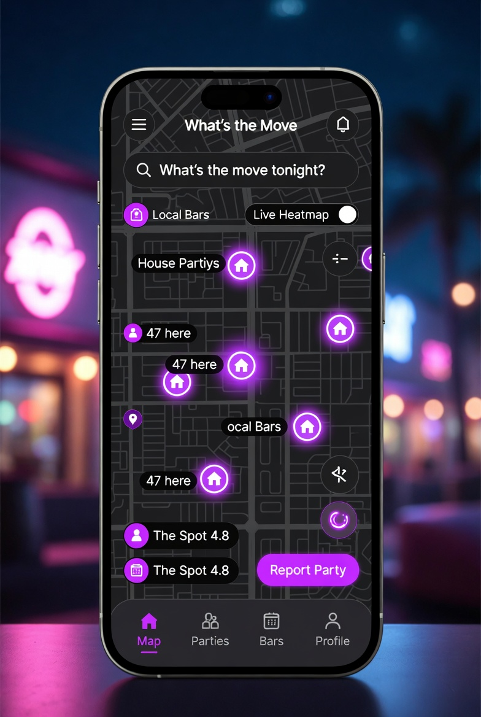
Our Solution: What's the Move
One app. Real-time map. House parties auto-detected. Bars with live vibes. Safety built-in.
Live Heatmap: See where the energy is right now
House Party Auto-Detect: Crowd-sourced hotspots + smart clustering
Bar Explorer: Ratings, specials, live crowd levels & deals
Community Vibes: Vote lit/mid/dead, share stories
Safety First: SOS, friend tracking, verified listings, tips
Built & ready. Privacy-first. Designed for Gen Z college students.

Slide 4
Massive Market Opportunity
16.2M
$39B
US Undergraduates
(Fall 2025)
US Bars & Nightclubs
Market (2025)
14.2%
$2.1B → $6.1B
CAGR College
Social Apps Market
College Social Apps
2024 → 2033
Target: Start with high-density party schools (TX, FL, CA, NY) → national expansion. Viral potential through social sharing & FOMO.

Slide 5
Competitive Landscape & Our Edge
FLOCK
Heatmaps + vibes for bars/events. Great but lighter on house parties.
→ We own house parties + deeper bar integration
DoorList
Event hosting, RSVPs, QR for frats/sororities.
→ We focus on discovery & real-time, not just management
Eventbrite/Meetup
General events. Not nightlife or college specific.
→ Hyper-focused on spontaneous college nights out
Our Moat: Specialized auto-detect for house parties + bars combo, privacy-first design, safety tools tailored for students, viral campus loops.

Slide 6


Business Model
Freemium + B2B Partnerships = Sustainable growth with strong unit economics.
Consumer (B2C)
Venue Partnerships (B2B)
Additional Revenue
• Free core experience (map, basic discovery)
• Featured listings & promoted deals for bars/clubs
• Affiliate commissions (Uber/Lyft, ticket platforms)
• Premium: $4.99/mo or $39/yr — ad-free, advanced filters, priority alerts, exclusive deals
• Analytics dashboard (anonymized crowd data)
• Sponsored events & branded content (responsible)
• High retention via FOMO & social proof
• Tiered pricing: $99–$499/mo depending on size & features
• Future: In-app ticketing for verified events (low fee)

Slide 7
Go-to-Market & Marketing Strategy
Phase 1: Pre-Launch
May – Aug 2026
Polish app • Legal/compliance setup • Landing page + waitlist • Recruit 50 campus ambassadors at 5 pilot schools (UT Austin, UF, UCLA, etc.) • Create TikTok/IG content engine • Bar partnership outreach in Dallas & pilot cities
Phase 2: Beta Launch
Sep – Dec 2026
Soft launch on 3-5 campuses with university email verification • Ambassador-led events & parties • Viral challenges (#WhatsTheMove) • Iterate on feedback • Target 10k-25k users
Phase 3: Expansion
Jan – May 2027
Roll out to 15-20 additional campuses • Add ticketing & more bar deals • Paid acquisition in key markets • First revenue from partnerships • 100k+ users target
Phase 4: Scale
Summer 2027+
National expansion • Premium & B2B ramp • International test markets • Potential Series A

Slide 8




Marketing Channels & Tactics
Organic Social & Viral
TikTok & Instagram Reels: Night-out vlogs, 'day in the life' with app, user stories. #WhatsTheMove challenge. User-generated content incentives (badges, premium trials).
Campus Ambassadors
Paid or incentivized reps on each campus. Host launch parties, tabling, Greek life outreach. Create local hype & trust.
Bar & Venue Partnerships
Co-branded nights, exclusive deals in-app, ambassador nights. Bars get visibility & foot traffic; we get listings + revenue share.
Paid Acquisition
Targeted TikTok/Meta ads to college towns, 18-24 demo. Lookalike audiences from early users. Retargeting warm leads.
PR & Influencers
College media (Daily Texan, etc.), tech/startup press. Micro-influencers (5k-50k followers) in Greek life & nightlife scenes.

Slide 9
Safety, Legal & Responsible Launch
Non-negotiable foundation. We build trust by protecting users and operating responsibly.
Privacy-First Design:
Opt-in location only. Anonymized aggregates for heatmaps. Clear consent flows. CCPA/GDPR ready.
Age & Content Controls:
21+ emphasis for bar features. Age gates where needed. No promotion of underage drinking. Strict moderation of listings.
Safety Tools:
In-app SOS button with location share. Friend tracking opt-in. Report unsafe events with quick review. Links to campus safety & rideshare.
Verification & Moderation:
Optional university email for credibility. AI + human review of party reports. Remove illegal or dangerous listings fast.
Legal Compliance:
Terms of service clear on user responsibility. No liability for user-hosted events. Partner with legal counsel for alcohol-adjacent marketing rules.

Slide 10
Success Metrics & Financial Outlook
Users (Year 1)
150k+ registered, 40k+ MAU
Engagement
30%+ D1 retention, 15%+ D30
Reports & Activity
5+ reports/user/month in active campuses
Revenue (Year 1)
$50k–$150k from early B2B + premium
Partnerships
25+ bars/venues signed by month 12
Safety Score
<0.1% incident rate, high verification %
Low burn: Lean team, viral growth focus. Path to profitability by end of Year 2 with disciplined expansion.

Slide 11
Key Risks & Mitigation
Low Adoption / Network Effects
Strong ambassador program + viral mechanics from day one. Start dense on few campuses before spreading thin.
Competition from FLOCK or new entrants
Double down on house party specialization + superior UX/safety. Move fast on features they lack (deeper bar deals).
Safety or Legal Issues
Robust moderation, clear policies, legal review upfront. Transparent communication builds trust even when issues arise.
Platform Policy Changes (App Store)
Diversify acquisition (web, SMS, ambassadors). Build owned channels (email, push, community Discord).

Slide 12

Let's Make Every Night Legendary
What's the Move is built. The market is hungry. The timing is perfect.
1. Finalize legal & safety framework (2-3 weeks)
2. Launch landing page + waitlist + ambassador recruitment
3. Complete app polish & beta testing infrastructure
4. Secure first 3-5 bar partnerships in pilot cities
5. Kick off content creation & social launch
Ready to launch? Let's connect and make it happen.
Kutter Thornton | kutter_thornton | Dallas, TX

